Slide 1
Mobile Opportunities in Young Africa
Victor Mantilla Colon

Slide 2
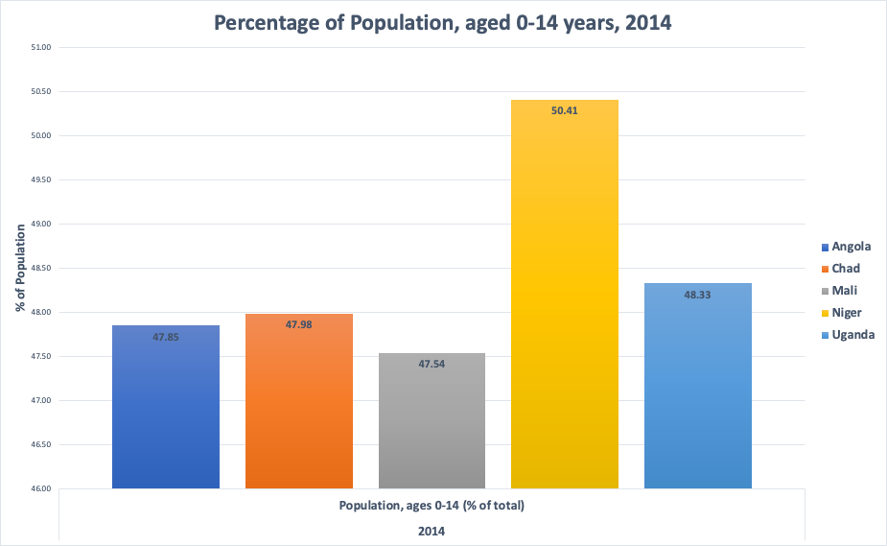
We are the world! We are the children!
I am interested in finding out more about the top 5 countries with the youngest populations aged 0-14 years old in 2014.
Hypothesis:
Should mobile companies target these countries?

Slide 3
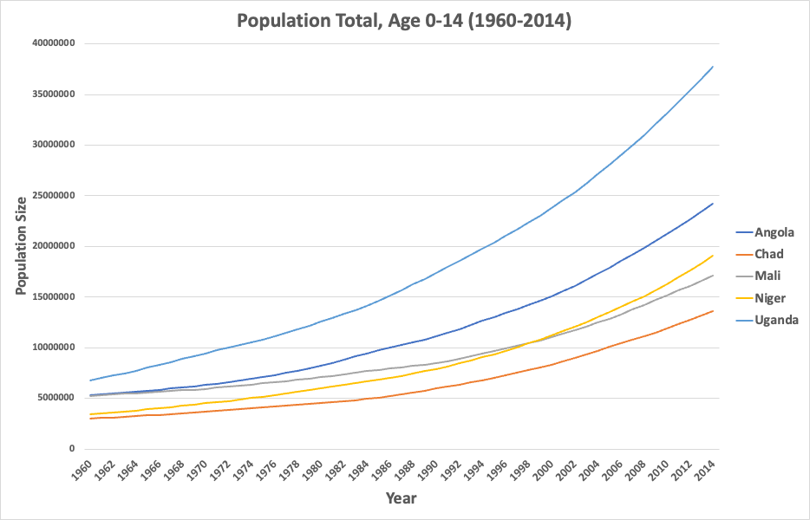
Each country has had a an explosion in population with Uganda growing to 38 million in 2014.

Slide 4
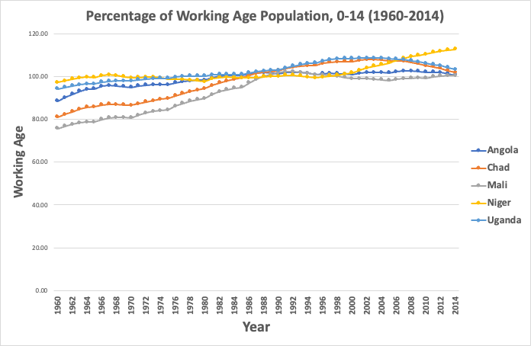
The working age population of these countries has at minimum been 76% of the population.
This trend has only increased throughout the subsequent decades.

Slide 5
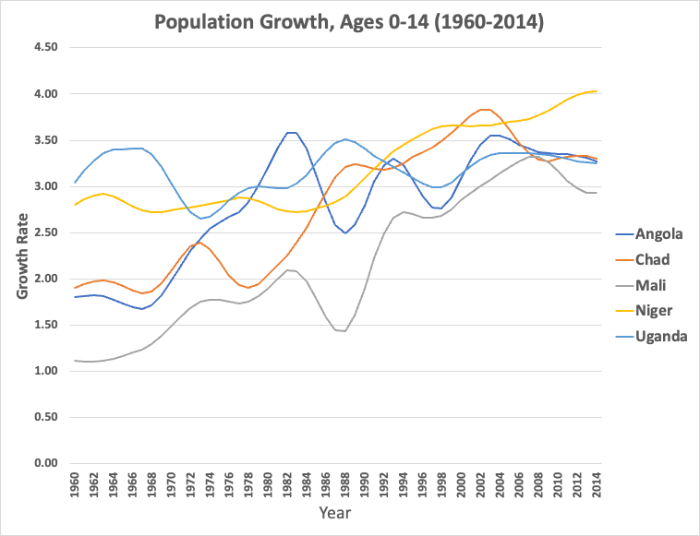
Population growth is a big driver in the overall hypothesis we are exploring.
The average global rate is 1.1% which these countries blow past.

Slide 6
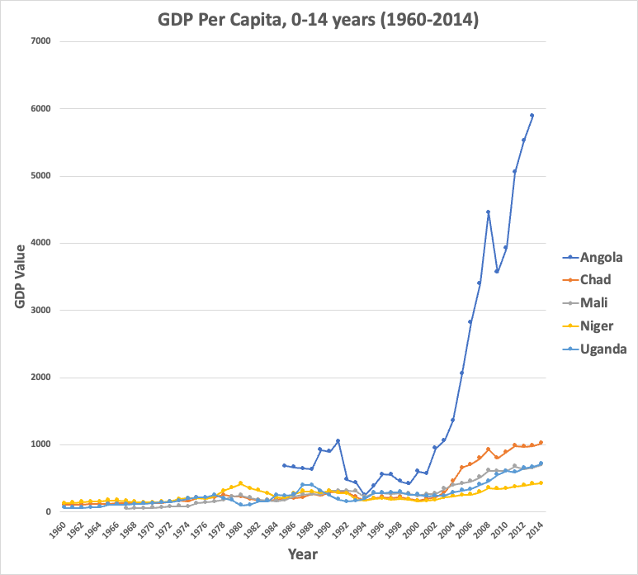
GDP Per Capita
Angola started tracking their GDP per capita in 1985 at $695 and increased to $5900 in 2014.
Angola has gone through a radical transformation following epic inner turmoil and has now enjoyed rapid growth due mostly as a result of high oil prices,
In addition, macroeconomic conditions such as a high level of net international reserves, exports, and fiscal revenues, a strengthening currency, and declining public debt to GDP.

Slide 7
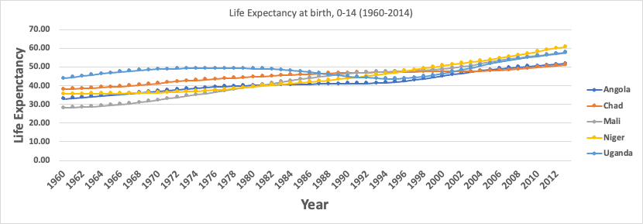
The life expectancy at birth has drastically improved from a low of 28 years in 1960 to a high of 58 years in Mali.
The highest life expectancy at birth is 61 years in Niger from a low of 33 in 1960.

Slide 8
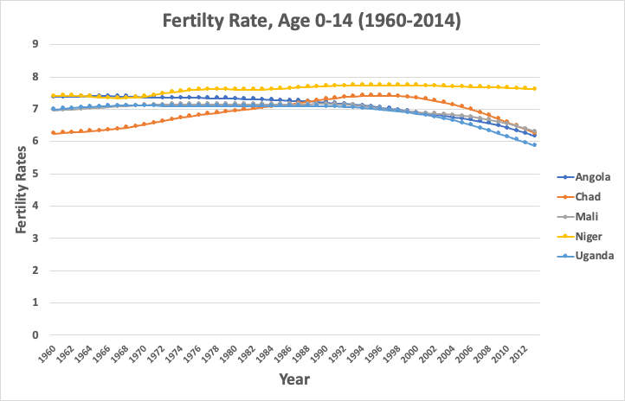
Niger has had a very steady fertility rate throughout the decades.
A wide variety of conflicts in the area may have contributed to the fluctuation of fertility rates throughout time, particularly for Chad and Mali.
Each country surpasses the global fertility of 2.5 in 2014.

Slide 9
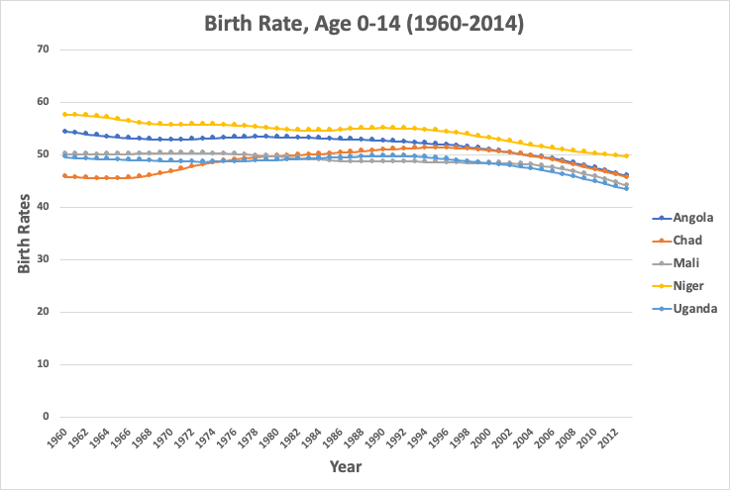
Birth rates for each country listed are very high in conjunction with the high fertility rates.
These two metrics are very important when measuring a country’s health in terms of birth/death/replacement rates.

Slide 10
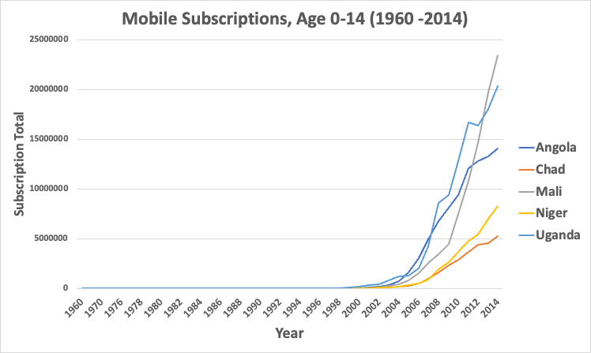
There are over 23 million mobile subscriptions in Mali in 2014
The population of Mali was 17.5 million in 2014!
What an opportunity!

Slide 11
Population Insights
The world population growth rate peaked in 1963 at 2.2% per year and subsequently declined. In 2017, the estimated annual growth rate was 1.1%.
The CIA World Factbook gives the world annual birthrate, mortality rate, and growth rate as 1.86%, 0.78%, and 1.08% respectively.
The last 100 years have seen a massive fourfold increase in the population, due to medical advances, lower mortality rates, and an increase in agricultural productivity made possible by the Green Revolution.
By 2100, the UN projects the population in Sub-Saharan Africa will reach 3.8 billion.
The main driver of long-term future population growth is projected to be the evolution of the global average fertility rate.

Slide 12
Thank you for listening!

